Slide 1
Financial Management
Lecture 7: Capital Investment Decisions

Slide 2
Learning Objectives
Identify the essential features of investment decisions, and state the four common capital investment appraisal methods
Demonstrate an understanding of the ‘accounting rate of return’ method with respect to the formula, decision rule, and strengths and weaknesses
Demonstrate an understanding of the ‘payback’ method with respect to the formula, decision rule, and strengths and weaknesses
Demonstrate an understanding of the ‘net present value’ method with respect to the formula, decision rule, and strengths and weaknesses

Slide 3
Learning Objectives (continued)
Demonstrate an understanding of the ‘internal rate of return’ method with respect to the formula, decision rule, and strengths and weaknesses
Identify and deal with a range of practical issues relating to investment appraisal
Describe investment appraisal in practice, and explain the need to link it with strategic planning.

Slide 4
Features of investment decisions and associated appraisal methods
The nature of investment decisions
The time factor
Making an outlay of something of economic value, usually cash, at one point in time, which is expected to yield economic benefits to the investor at some other point in time
Investment decisions are of crucial importance for the following reasons:
Large amounts of resources are often involved, therefore, if mistakes are made, the effect can be catastrophic
It is often difficult and expensive to ‘bail out’ of an investment once it has been made

Slide 5
What is capital budgeting?
Capital budgeting is the analysis of potential projects to determine which projects the firm should undertake i.e. choose the projects that will increase the value of the company.
Capital budgeting techniques help management to systematically analyse potential business opportunities in order to decide which ones are worth undertaking.

Slide 6
Methods of investment appraisal
Four main methods used in practice to evaluate investment opportunities:
accounting rate of return (ARR)
payback period (PP)
net present value (NPV)
internal rate of return (IRR)
Some smaller businesses may use informal methods, such as managers’ instincts
Notes:
What it is?
What is the calculation?
What is the decision rule?
What is the advantage and disadvantages?

Slide 7
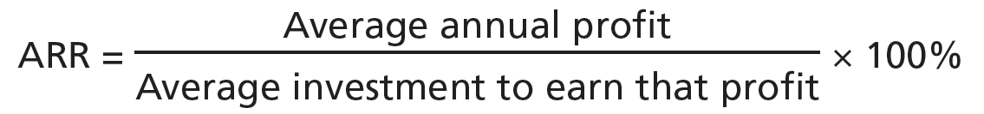
Accounting rate of return (ARR)
ARR takes the average accounting profit the investment will generate, and expresses it as a percentage of the average investment in the project as measured in accounting terms:
The calculation requires:
the annual average profit
the average investment for the particular project

Slide 8
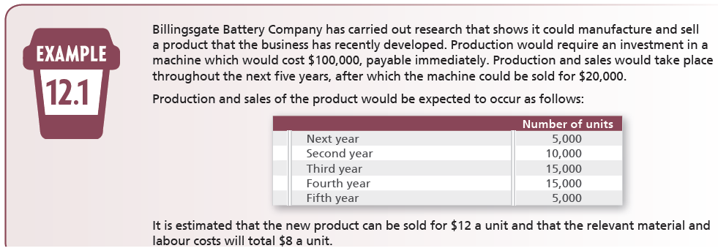
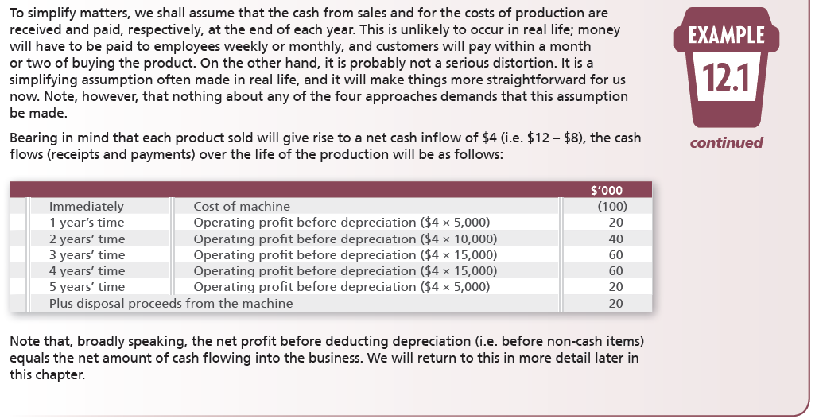
Example 12.1

Slide 9
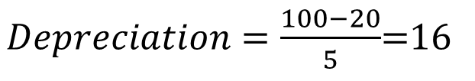
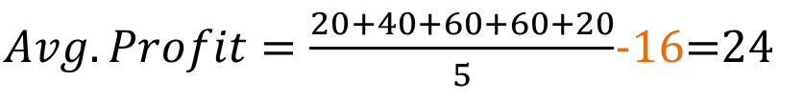
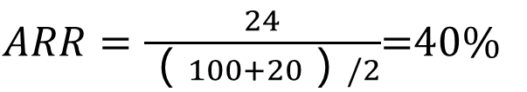
Example 12.1 continued
 | Year | $’000
Beginning of year | 1 | 100
At the end of year | 1 | 84 (i.e. 100 – 16)
 | 2 | 68 (i.e. 84 – 16)
 | 3 | 52
 | 4 | 36
 | 5 | 20

Slide 10
Accounting rate of return (ARR)
Decision rules
For any project to be accepted, it must achieve a target ARR as a minimum
If there are competing projects that exceed the minimum rate, the one with the highest ARR would normally be chosen
Advantages
Easy to calculate and understand
Is a measure of profitability that is consistent with ROCE (based on accrual performance)

Slide 11
Accounting rate of return (ARR)
Problems with ARR
ARR uses accounting profit; however, over the life of a project, cash flows matter more than accounting profits
ARR fails to take into consideration the time value of money
The ARR method presents averaging difficulties
Issues with competing projects of different size

Slide 12
Time Value of Money
 | Project
 |  | A | B | C
Time |  | $’000 | $’000 | $’000
Immediately | Cost of machine | (160) | (160) | (160)
1 year’s time | Operating profit after depreciation | 20 | 10 | 160
2 years’ time | Operating profit after depreciation | 40 | 10 | 10
3 years’ time | Operating profit after depreciation | 60 | 10 | 10
4 years’ time | Operating profit after depreciation | 60 | 10 | 10
5 years’ time | Operating profit after depreciation | 20 | 160 | 10

Slide 13
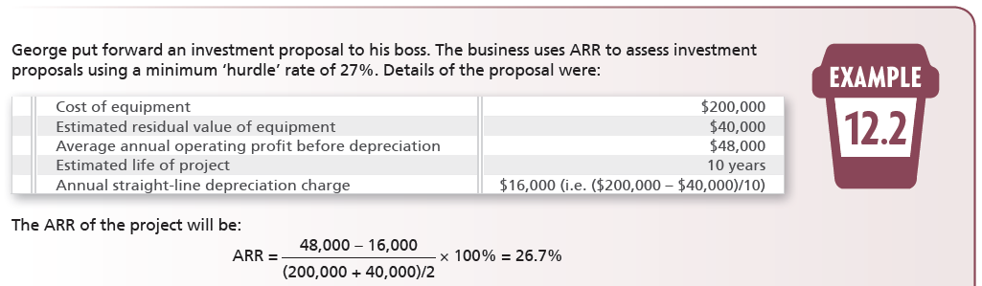
Averaging difficulties

Slide 14
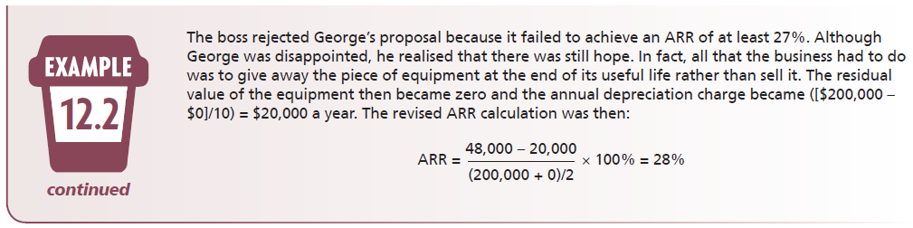
Averaging difficulties

Slide 15
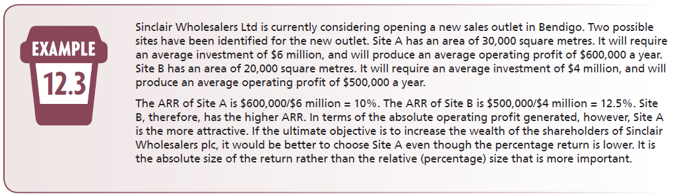
Competing projects of different size

Slide 16
Payback period (PP)
PP = The length of time taken for the initial investment in a project to be repaid from the net cash inflows of the project
Decision rules
For a project to be acceptable, it would need to be within a maximum payback period
If there are competing projects, the project with the shorter payback period would be chosen
Advantages
Quick and easy to calculate, emphasises the short term
Disadvantages
Disregards timing of cash flows, excludes post-payback period cash flows

Slide 17
Example 12.1

Slide 18

Payback period (PP)
TIME |  | NET CASH FLOWS $’000 | CUMULATIVE YEAR CASH FLOWS $’000
Immediately | Cost of machine | (100) | (100)
1 year’s time | Operating profit before depreciation | 20 | (80)
2 years’ time | Operating profit before depreciation | 40 | (40)
3 years’ time | Operating profit before depreciation | 60 | 20
4 years’ time | Operating profit before depreciation | 60 | 80
5 years’ time | Operating profit before depreciation
 | Plus disposal proceeds | 40 (20 + 20) | 120
$$Payback Period=Years before cost recovery+\frac{Remaining cost to recover}{Cash flow during the year}=2+\frac{40}{60}=2.67 years$$

Slide 19
Issue with Payback Period
 |  | Project 1 $’000 | Project 2 $’000 | Project 3 $’000
Immediately | Cost of machine | (200) | (200) | (200)
1 year’s time | Operating profit before depreciation | 40 | 10 | 80
2 years’ time | Operating profit before depreciation | 80 | 20 | 100
3 years’ time | Operating profit before depreciation | 80 | 170 | 20
4 years’ time | Operating profit before depreciation | 60 | 20 | 200
5 years’ time | Operating profit before depreciation | 40 | 10 | 500
 | Plus disposal proceeds | 40 | 10 | 20

Slide 20
Net present value (NPV)
Compares sum of present value of all expected cash inflows with present value of expected cash outflows
Decision rules
Accept the highest positive NPV, reject all negative NPVs
Advantages
Considers all of the costs and benefits of each investment opportunity
Makes allowance for the timing of these costs and benefits
Disadvantages
More difficult to calculate, less easily understood
Does not determine actual rate of return or a relative measure of return

Slide 21
Net present value (NPV)
There are three steps in the NPV method:
Estimate future cash flows
Determine the investor’s cost of capital or required rate of return
Calculate the present value of the future cash flows and decide whether to accept or reject the project

Slide 22
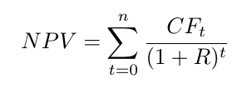
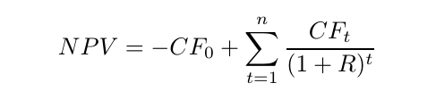
Net present value= sum of the PVs of all cash flows
NOTE: t=0
Projects usually involve initial costs (outflow), so we can rewrite the equation and separate out the initial cost, CF₀:
Notes:
The initial cost is to set up the project eg buy equipment or buildings

Slide 23
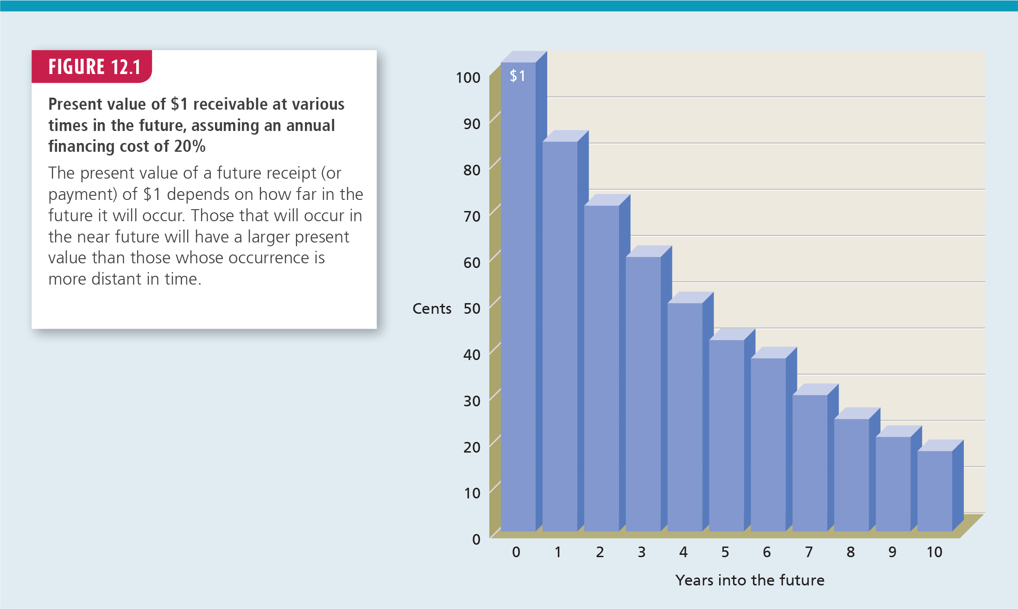
Notes:
Figure 12.1

Slide 24
Net present value (NPV)
Interest lost – unless the opportunity to invest delivers returns better than a risk-free rate of return, then opportunity costs are incurred; any acceptable investment opportunity must deliver returns better than those available from the next best opportunity
Inflation – compensation for loss of purchasing power is reflected in interest rates

Slide 25
Net present value (NPV)
Risk – in practice, a higher rate of return is expected from projects when the risk seems higher
A risk premium is a rate of return in excess of that which would be expected from a risk-free investment to compensate the investor for bearing that particular risk
The logical investor will choose only those investments that will compensate for the loss of interest, loss of purchasing power and risk
The decision rule is simple – if the NPV is positive, the project is acceptable; if negative, it is rejected. Assuming unlimited funding.

Slide 26
Net present value (NPV)
Actions of a logical investor
The logical investor seeking to increase his or her wealth will choose only those investments that will compensate for the loss of interest, the loss of purchasing power of the money invested, and the risk (the fact that the expected returns may not materialise).
Investors need at least the minimum return before they are prepared to invest.
Notes:
A-Head added.

Slide 27
Example 12.1

Slide 28
Net present value (NPV)
 | CASH FLOW | CALCULATION OF PV | PV
TIME | $’000 |  | $’000
Immediately (time 0) | (100) | (100)/(1 + 0.2)° | (100.00)
1 year’s time | 20 | 20/(1 + 0.2)¹ | 16.67
2 years’ time | 40 | 40/(1 + 0.2)² | 27.78
3 years’ time | 60 | 60/(1 + 0.2)³ | 34.72
4 years’ time | 60 | 60/(1 + 0.2)⁴ | 28.94
5 years’ time | 40 (20 + 20) | 40/(1 + 0.2)⁵ | 16.08
 |  |  | 24.19

Slide 29
Net present value (NPV)
Why NPV is superior to ARR and PP
The timing of the cash flows – discounting the various cash flows when they are expected to arise acknowledges that not all cash flows occur simultaneously
The whole of the relevant cash flows – NPV includes all of the relevant cash flows irrespective of when they are expected to occur
The objectives of the business – NPV is the only method in which the output bears directly on the wealth of the business

Slide 30
Net present value (NPV)
Two potential limitations
The actual return percentage is unknown – NPV simply reveals if the projected return is either higher (+) or lower (–) than the discount rate, not how much higher or lower
Ranking of alternative projects – If funds are limited, NPV does not enable ranking of positive projects and, therefore, the best investment strategy may not be determined

Slide 31
Discounted payback
Whereas the payback period (PP) method does not take into consideration the time value of money, discounted payback compares the initial cost with the cash inflows after discounting

Slide 32
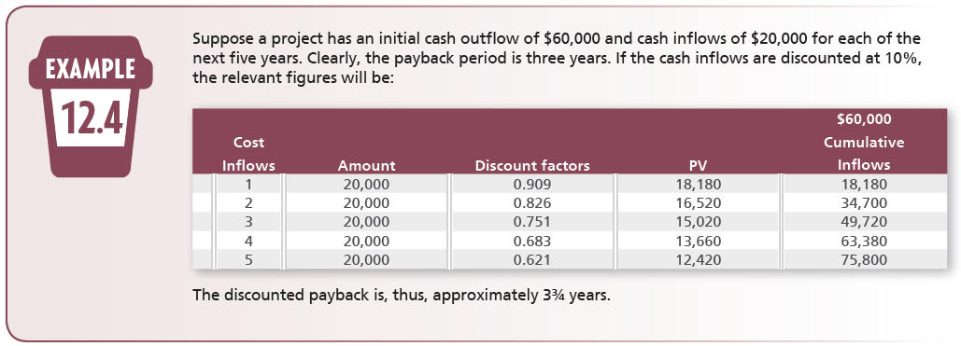
Example 12.4

Slide 33
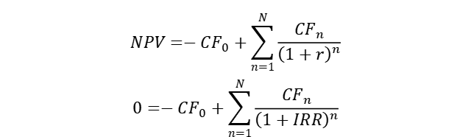
Internal rate of return (IRR)
The IRR is the discount rate that makes the NPV to equal zero
Mathematically, we can write this by rearranging the NPV formula :
IRR is an expected rate of return, much like the yield to maturity calculation that was made on bonds
Need to apply the same trial-and-error method to calculate the IRR
$$NPV=−CF_{0}+\sum_{n=1}^{N}{\frac{CF_{n}}{{\left(1+r\right)}^{n}}}$$
$$0=−CF_{0}+\sum_{n=1}^{N}{\frac{CF_{n}}{{\left(1+IRR\right)}^{n}}}$$
Notes:
Trial and error is required in exam to do IRR

Slide 34
Internal rate of return (IRR)
The IRR is an important and legitimate alternative to the NPV method
The NPV and IRR techniques are similar in that both depend on discounting the cash flows from a project
When we use the IRR, we are looking for the rate of return associated with a project
IRR has intuitive appeal to managers because it is a return, which is easy to understand
We will accept the project if the IRR is greater than the company’s cost of capital.

Slide 35
Example 12.1
TIME | CASH FLOW $’000 | DISCOUNT FACTOR (r=30%) | PV $’000
Immediately (time 0) | (100) | 1.000 | (100.00)
1 year’s time | 20 | 0.769 | 15.38
2 years’ time | 40 | 0.592 | 23.68
3 years’ time | 60 | 0.455 | 27.30
4 years’ time | 60 | 0.350 | 21.00
5 years’ time | 40 (20 + 20) | 0.269 | 10.76
 |  |  | (1.88)

Slide 36
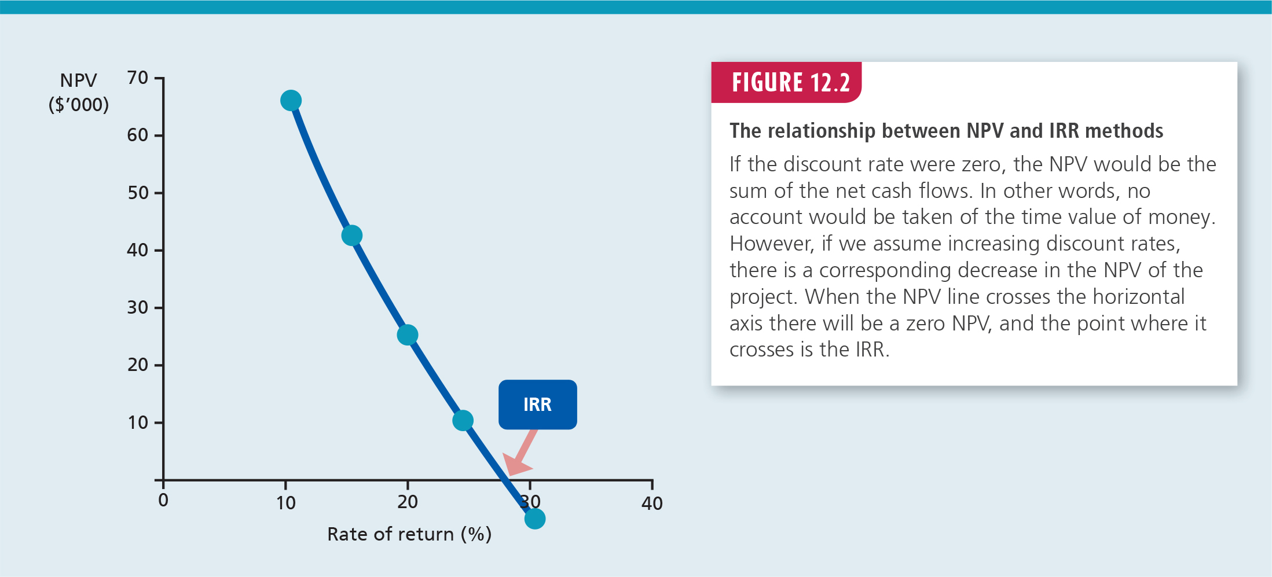
Internal rate of return (IRR)

Slide 37
IRR Issue 1 – unconventional cash flows
Unconventional cash flows could follow several different patterns
A positive initial cash flow followed by negative future cash flows
Future cash flows from a project could include both positive and negative cash flows
A cash flow stream that looks similar to a conventional cash flow stream except for a negative final cash flow
In these circumstances, the IRR technique can provide more than one solution. This makes the result unreliable and should not be used in deciding about accepting or rejecting a project

Slide 38
IRR Issue 1 – unconventional cash flows
Example: A mining project has an initial cost of $55 million. In the first year, it will generate cash inflows of $150 million, and in the second year environmental restoration of the site will cost $100 million
The cost of capital is 20%
This project has unconventional cash flows because the cash flow in year 2 is -$100 million
We can examine the relationship between NPV and IRR for this project using an NPV profile
This is a graph which shows the NPV at different rates of return

Slide 39
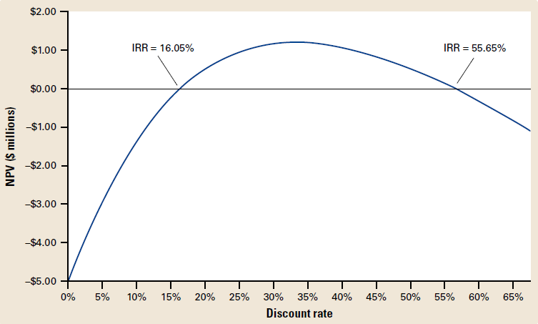
NPV profile
Notes:
We can see from the graph that there are TWO rates that make NPV=0
i.e. 2 IRRs
The cost of capital is 20% therefore we don’t know if we should accept or reject the project because one IRR is below the C of C and the other is above

Slide 40
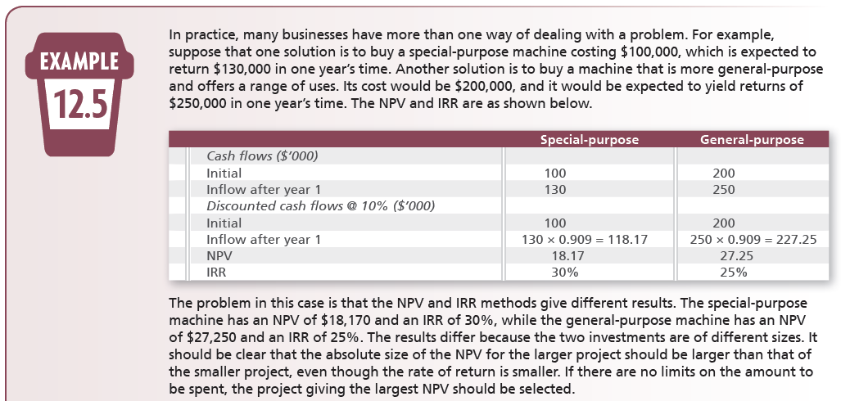
IRR Issue 2 - Ranking mutually exclusive projects

Slide 41
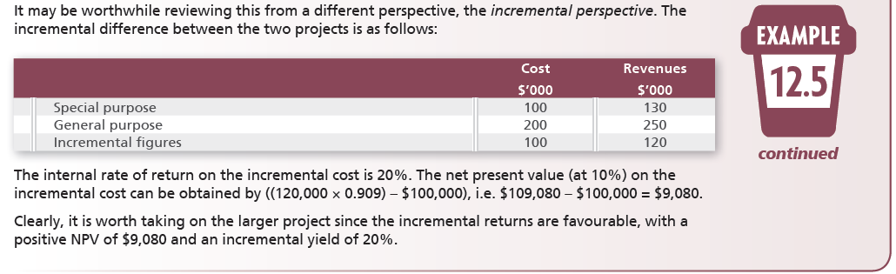
IRR Issue 2 - Ranking mutually exclusive projects

Slide 42
A comparison of the DCF methods
For most projects, a simple accept or reject decision should be the same
Differences arise in the conclusions between IRR and NPV in the following situations:
mutually exclusive projects
capital rationing situations
Mutually exclusive projects are projects where a choice has to be made between alternatives, but in which only one can actually be undertaken

Slide 43
A comparison of the DCF methods
Capital rationing occurs when there are limits imposed on the amount of capital invested
Capital rationing leads to the need to rank projects in some way, which is a problem for the NPV method
There are two common strategies to overcome this problem:
profitability index or benefit/cost ratio
NPV per $1 of investment

Slide 44
Some practical points - Only Incremental Cash Flow Matters
Relevant costs should be determined and used, e.g. ignore costs already incurred, past costs, etc.
Future costs should also in some cases be ignored, e.g. costs that will be incurred whether or not the project goes ahead
Opportunity costs arising from benefits foregone must be included
Taxation on profits and also tax relief should be accounted for
Interest payments should not be included when using DCF techniques as the discount factor already takes account of cost of financing

Slide 45
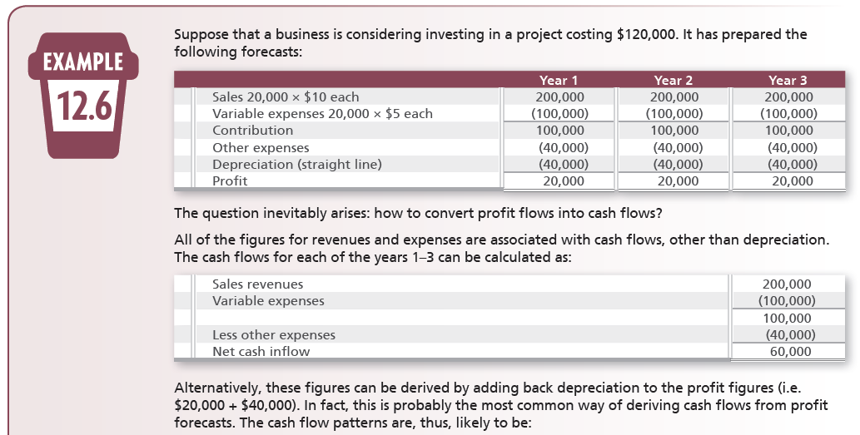
Working Capital - Example 12.6
continues

Slide 46
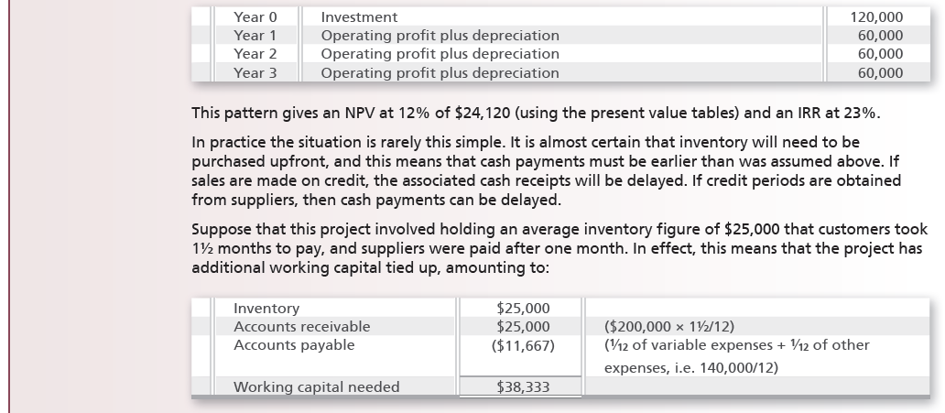
Example 12.6 continued
continues

Slide 47
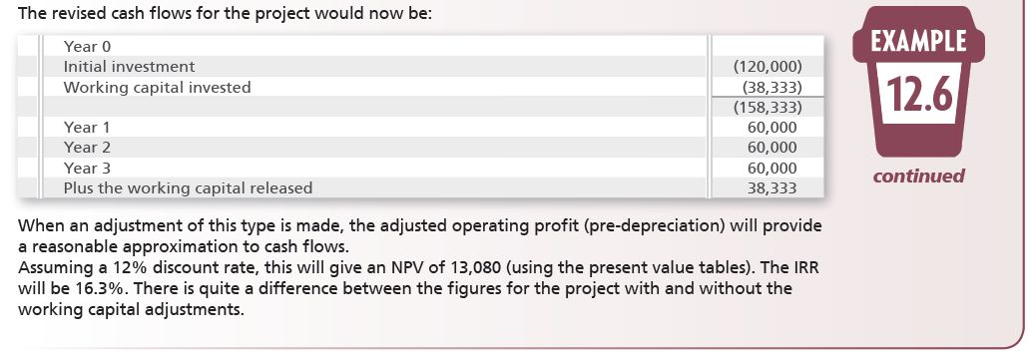
Example 12.6 continued

Slide 48
Investment appraisal in practice
Research shows that businesses tend to use more than one method to assess each investment decision
NPV and IRR seem to be the more popular methods used in practice
ARR and PP continue to be popular despite their shortcomings and the rise of popularity of the DCF methods
Large businesses tend to use the discounting methods and apply multiple methods for each decision

Slide 49
Investment appraisal and planning systems
Investment appraisal methods are an important part of the planning and decision-making process
Cash flow estimates need to be prepared in a competent manner such that the implications of following through on the estimates are clear
Capital investment appraisal needs to be fully integrated in the broader strategic planning and decision-making system
Strategic planning should be a conduit through which investments must pass so that all aspects can be considered, e.g. human, behavioural, environmental, etc.

Slide 50
Practice Questions

Slide 51
Q1
Joe is considering setting up a business selling free-range chickens. He estimates his establishment costs will be $600,000 and his net cash flows for the first five years will be $100,000 in year 1, $200,000 in year 2, stabilising at $250,000 in year 3. The payback period for the investment is:
A) 3 years.
B) 3.2 years.
C) 5 years.
D) 3.8 years.

Slide 52
Q2
The following data was given for three projects being considered by Manosteel Ltd. Only one project can be accepted due to funding limitations.
Project IRR NPV Payback
A 16% $18,000 7 yrs
B 18% $100,000 5 yrs
C 15% $95,000 10 yrs
Which project is the best given that Manosteel's required rate of return is 14%?
A) Project A.
B) Project B.
C) Project C.
D) All projects should be accepted, as all have a positive Net Present Value and an Internal Rate of Return greater than the required rate of return.

Slide 53
Q3
Container Ltd, a manufacturing firm, is considering investing $100,000 in a new mainframe computer. It is estimated that net cash flow per year will be $25,000 and the computer will have a 10-year useful life and zero residual value. The machine will be depreciated on a straight-line basis. What is the accounting rate of return?
A) 70.0%.
B) 50.0%.
C) 25.0%.
D) 30.0%.

Slide 54
Q4
TG Industries is considering investing in a fleet of six delivery vehicles. The annual running costs are expected to total $90,000 per vehicle, including the driver's salary. The vehicles are expected to operate for a total of five years.
At present TG industries uses a commercial carrier for its deliveries. The commercial carrier is expected to charge a total of $680,000 for each of the next five years to make the deliveries.
What is the estimated net annual cash cost saving on delivery vehicle running cost if TG industries invests in the fleet of six vehicles?
A) $90,000.
B) $400,000.
C) $310,000.
D) $140,000.

Slide 55
Q5
Wishlist recently purchased a new packaging machine for $678,026. The machine has a remaining useful life of 10 years. Net cash flow per year will be $120,000. The internal rate of return is:
A) 16%.
B) 20%.
C) 24%.
D) 12%.

